Slide 1
The cost of AI
Michael Mrissa
University of Primorska
Spring 2026

Slide 2
Introduction
The question we don‘t ask:
Under which conditions is it acceptable to use it?
The usual question about AI
  How shall we use it?
Often overlooked questions about AI
  What is the cost of using it?
  What is the benefit/ratio cost?
  What are the implications behind its usage?
Just like any tool
  The potential to serve humanity exists, if used reasonably well
  It has a production cost in the equation
  It also has consequences due to usage

Slide 3
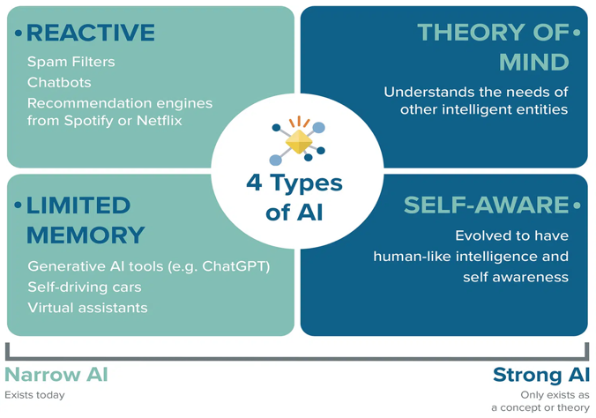
AI definition
Group of technologies that process information and simulate human activities
Such activities include understanding, learning, creating, reasoning, decision making, …
Science aiming at automating the process of learning machines to perform tasks
https://www.aitechboss.com/types-of-ai/

Slide 4
AI benefits
Makes everyday tasks faster
Usually works like an assistant
Through interactive prompt
Simulates human dialogue
Provides some support
Needs to be double-checked
Usual AI task examples
  Summarize long documents
  Write draft emails
  Manage and schedule tasks
  Help with decisions
  Generate creative contents
  Help with trip planning
  Give short definitions

Slide 5
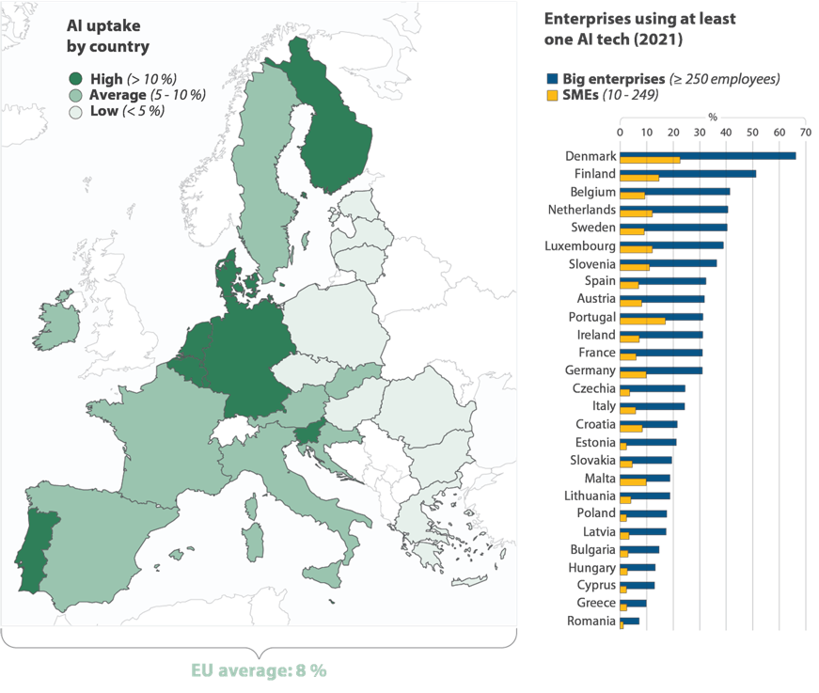
AI uptake in Europe
Massive adoption
  Large companies
  Followed by SME
Not only companies
  1/3 of the 16-74 population used AI in 2025
  25% for personal purposes
  15% of them for work
  9% for formal education
Source: ECA, based on latest Eurostat data.

Slide 6
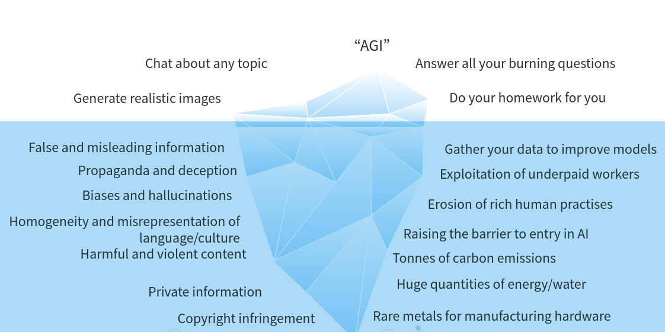
AI issues
© Dr. Sasha Luccioni. Source: https://arstechnica.com/gadgets/2023/04/generative-ai-is-cool-but-lets-not-forget-its-human-and-environmental-costs/

Slide 7
AI cost: multiple dimensions
Material resources
  electricity, water, servers, chips, and data-centre infrastructure (de Vries, 2023; Li et al., 2025)
Economical cost
  low pay, economic dependency, outsourcing, surveillance, secrecy, and weak labour protections in parts of the AI data-work pipeline (Miceli & Posada, 2022; Miceli et al., 2024)
Psychological damage
  Data filtering work expose workers to significant mental-health risks (Miceli et al., 2024)
  Also its usage can be damaging (Dang, Liu, 2025)

Slide 8
AI cost: some numbers
Carbon footprint and water footprint
  1 short GPT-4o query consumes 0.43 Wh
  Scale this to 700 million queries/day, you get…
Huge environmental impact
  electricity use comparable to 35,000 U.S. homes
  freshwater evaporation matching the annual drinking needs of 1.2 million people
  carbon emissions requiring a Chicago-sized forest to offset
Estimation for GPT-3
  Around 30 prompts consumes around ½ liter of water
Energy needed for a prompt vs email
  Estimated 10 to 100 times higher for a prompt

Slide 9
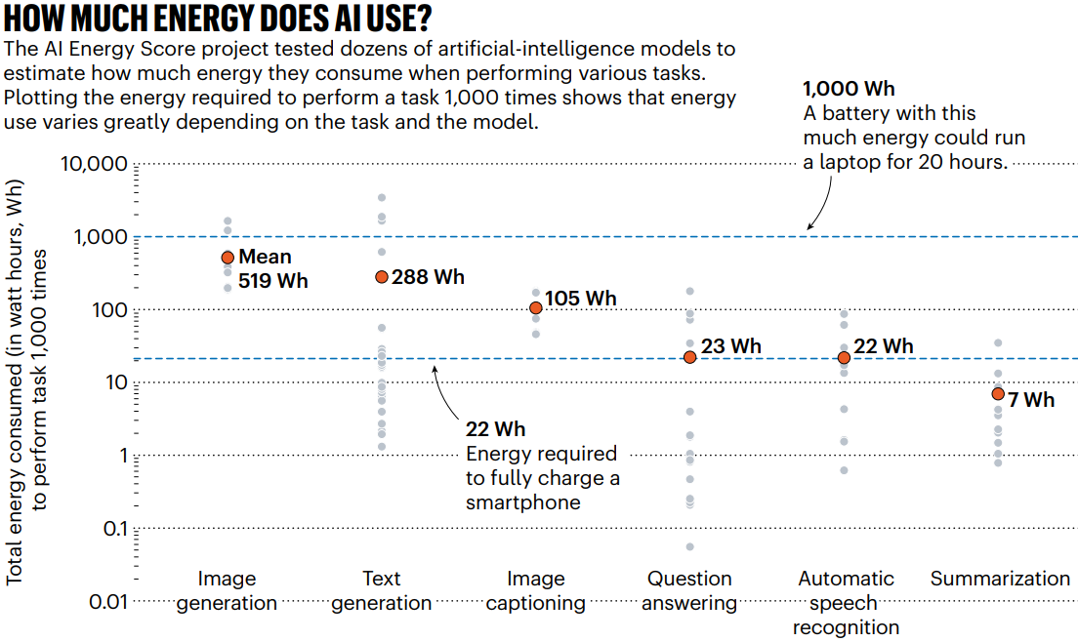
Energy cost comparison
© Chen, 2025

Slide 10
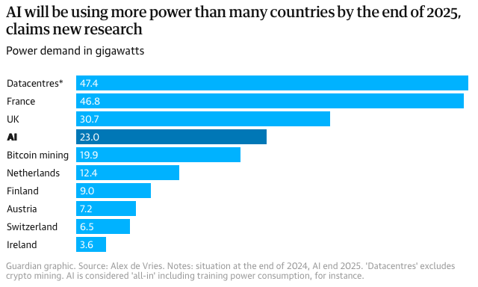
Cost comparison with countries

Slide 11
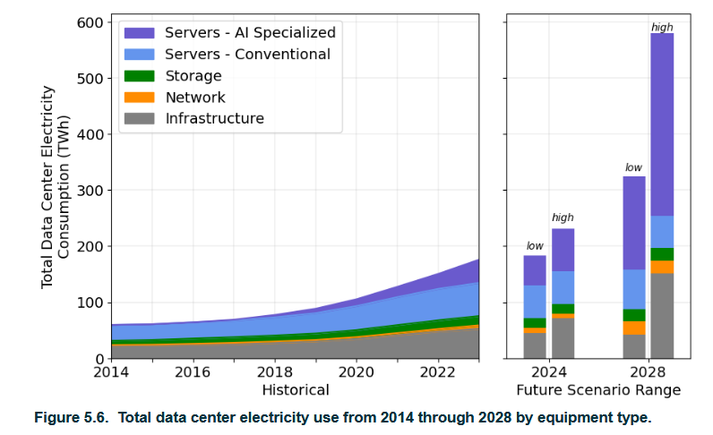
Data center electricity usage and AI
Poland electricity
Consumption in 2025
is approx. 167TWh
© Shehabi, 2024

Slide 12
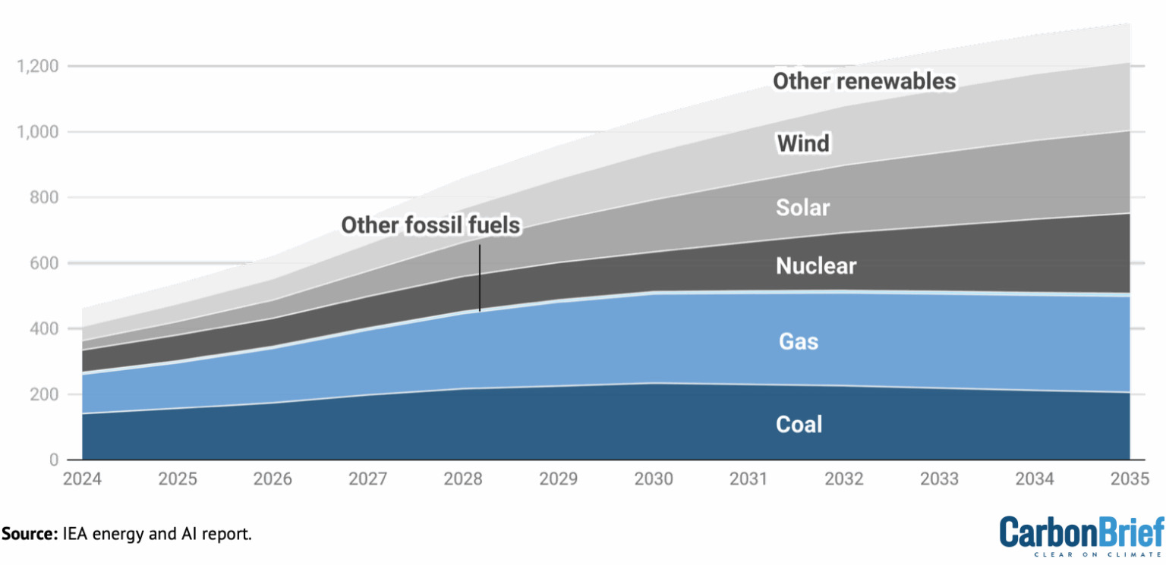
Data centers and fossil fuels

Slide 13
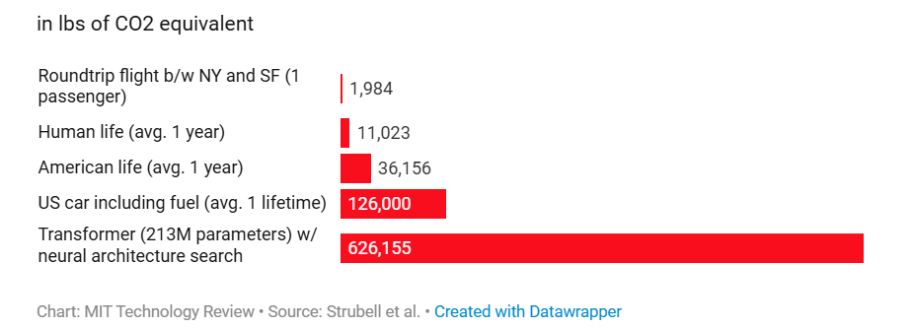
Carbon footprint comparisons
1 lb ≈ 0.45 kg → 1,984 lbs ≈ 900 kg

Slide 14
Processing the AI data
Human tasks in AI
  Before training: data generation, collection, filtering, annotation
  During training: assessing model responses (true/false)
  After training: Impersonation: replacing AI in some contexts
    Yes, they do ask humans to pretend and reply like a machine.
Those tasks remains human-based
  They are outsourced in platforms, using underpaid workers
  With NDAs, surveillance, isolation, less support (healthcare, pension)
  Vulnerable populations are targeted: refugees, prisoners, children
  (Miceli, 2024)

Slide 15
AI usage: the psychological cost
The AI bias
  Conveys the a certain bias that the data it builds on has
  Online data producers do not reflect the world population
Dimensions of the bias
  Imperialist worldview, white supremacist views, gender-biased views, (you-name-it)-phobic views…
  Are more present in the generated knowledge model (Katz, 2020)
Many examples in the news
  Such as the Dutch authority scandal
  An AI-assisted program wrongly accused 26000 families of fraud for child support declaration

Slide 16
AI usage: the psychological cost
Psychological dependency and attachment formation
  Users often anthropomorphize AI systems
Parasocial attachment
  Leads to delusional thinking, emotional dysregulation, and social withdrawal
Crisis incidents and harmful outcomes
  Cognitive impairment and addictive behaviors linked to prolonged AI use
Heightened vulnerability among specific populations
  Adolescents, elderly adults, and individuals with mental illness
Need for validated diagnostic criteria, clinician training, ethical oversight, and regulatory protection
© Head, 2025

Slide 17
Conclusion
The decision to use AI belongs to the user
  The costs and consequence of AI must be known
The objective of this set of slides
  Is to inform about what is often silenced
  To contribute to better clarity about this tool
  To raise awareness about its impact
Feel free to improve these slides
  Just send me back your improved version, I might update this one
This document is available under Creative Commons Attribution-NonCommercial-ShareAlike 4.0 International license
https://creativecommons.org/licenses/by-nc-sa/4.0/
It means anyone can improve the slides but always need to mention the original work, cannot change to a new license, and cannot make business with it

Slide 18
References
AI bias slides - https://web.stanford.edu/class/archive/cs/cs224n/cs224n.1194/slides/cs224n-2019-lecture19-bias.pdf
© Scientist rebellion Finland, round table, Tiedekulma (2025). AI: discussion on environmental and social costs. https://www.youtube.com/watch?v=lxWnRpZO6RQ
Chen, S. (2025). How much energy will AI really consume? The good, the bad and the unknown. Nature, 639(8053), 22-24.Dang, J.,Liu, L., (2025). Dehumanization risks associated with artificial intelligence use. American Psychologist
De Vries, A. (2023). The growing energy footprint of artificial intelligence. Joule, 7(10), 2191-2194.
Eurostats news (Dec. 2025). Online: https://ec.europa.eu/eurostat/web/products-eurostat-news/w/ddn-20251216-3
Head KR. (2025). Minds in Crisis: How the AI Revolution is Impacting Mental Health. J Ment Health Clin Psychol 9(3): 34-44
IEA (2025), Energy and AI, IEA, Paris Online: https://www.iea.org/reports/energy-and-ai, Licence: CC BY 4.0
Katz Y. (2020). Artificial Whiteness - Politics and Ideology in Artificial Intelligence, Columbia University Press, 2020

Slide 19
References
Li, P., Yang, J., Islam, M. A., & Ren, S. (2025). Making ai less” thirsty”: Uncovering and addressing the secret water footprint of ai models
Miceli, M., & Posada, J. (2022). The data-production dispositif. Proceedings of the ACM on human-computer interaction, 6(CSCW2), 1-37.
Miceli, M., Tubaro, P., Casilli, A. A., Le Bonniec, T., Wagner, C. S., & Sachenbacher, L. (2024). Who Trains the Data for European Artificial Intelligence? (Doctoral dissertation, European Parliament; The Left).
Shehabi, A., Smith, S.J., Hubbard, A., Newkirk, A., Lei, N., Siddik, M.A.B., Holecek, B., Koomey, J., Masanet, E., Sartor, D. (2024). United States Data Center Energy Usage Report. Lawrence Berkeley National Laboratory, Berkeley, California. LBNL-2001637
Strubell, E., Ganesh, A., & McCallum, A. (2019, July). Energy and policy considerations for deep learning in NLP. In Proceedings of the 57th annual meeting of the association for computational linguistics (pp. 3645-3650).
Jegham, N., Abdelatti, M., Koh, C. Y., Elmoubarki, L., & Hendawi, A. (2025). How hungry is ai? benchmarking energy, water, and carbon footprint of llm inference. arXiv preprint arXiv:2505.09598.

